Slide 1

TravidWallet
Travel Covid-19 Currency Converter:
Prepare your travels, the safe way

Slide 2

TravidWallet
User Story
AS A user who wants to securely log into a travel application
I WANT to be ensured that my personal data is securely stored
SO THAT I may select and view a country’s Covid-19 statistics and be able to read, create, update, and delete my currency converted traveling budget plans as needed

Slide 3
TravidWallet Technologies Used
HTML/CSS
JS
Bootstrap
Handlebars
Node
Express
MySQL
ReactJS
MySQL
Heroku

Slide 4
TravidWallet
Demonstration

Slide 5
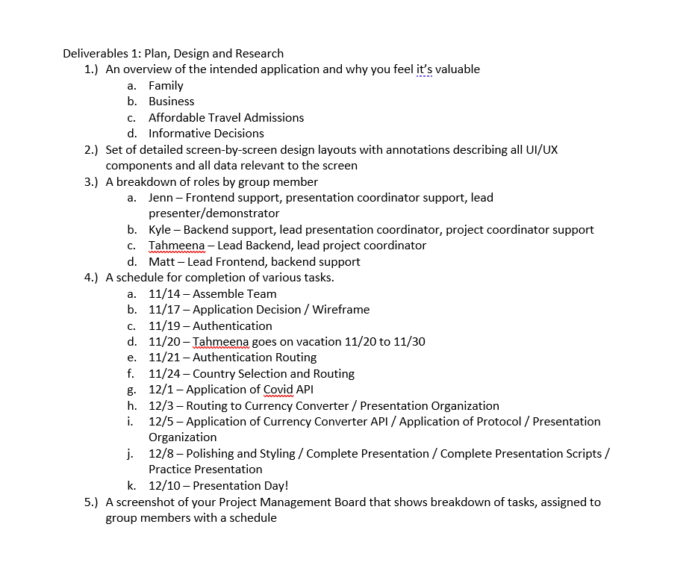
TravidWallet Project Management Board

Slide 6
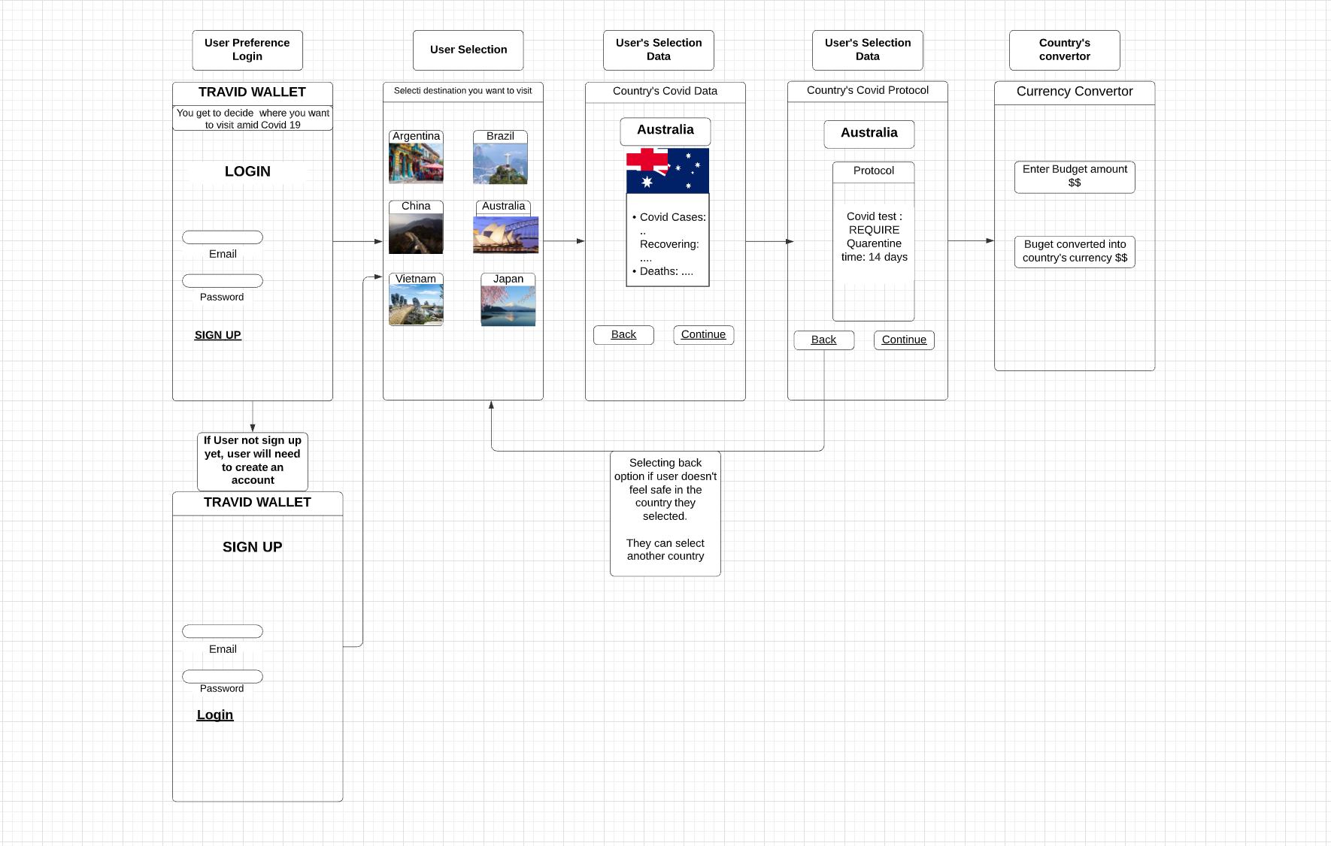
TravidWallet UI/UX Flow

Slide 7
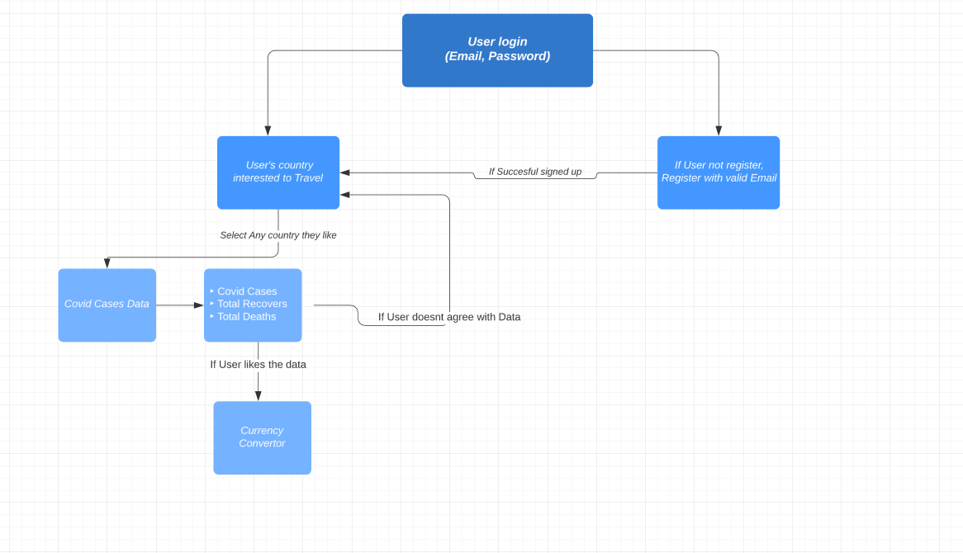
TravidWallet
Data Flow

Slide 8
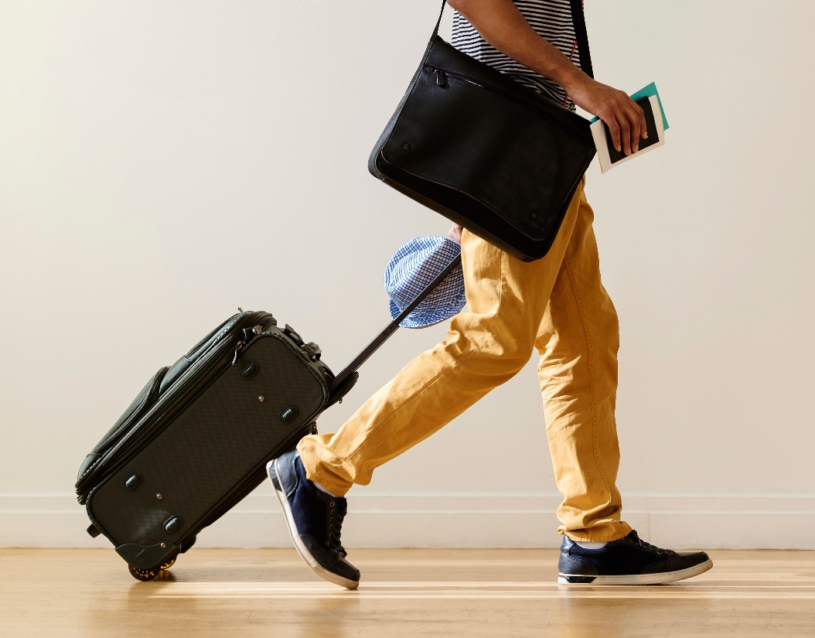


TravidWallet
Challenges
Authentication
Currency Converter
Rendering Content within Components
Routing
API implementation
Deployment

Slide 9
TravidWallet
Future Development
Integration of Travel Accommodation Information
Integration of Tour Guide Information
Integration of Local History
Expanded Country List

Slide 10
TravidWallet
Team Members
Jennifer Aguirre
- Frontend Support
- Presentation Coordinator Support
- Presenter / Demonstrator Lead
Tahmeena Javed
- Backend Lead
- Project Coordinator Lead
Kyle Brazier
- Frontend/Backend Support
- Presentation Coordinator Lead
- Project Coordinator Support
Matt Rikard
- Frontend Lead
- Backend Support

Slide 11
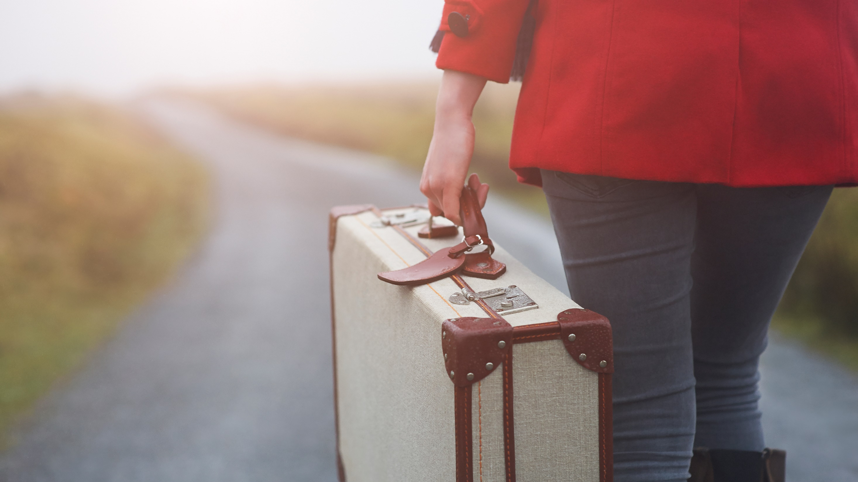
Thank you!
https://github.com/tjaved12/travelorsApp
https://still-waters-92313.herokuapp.com/

